Slide 1



AI-Based Smart Food Waste Reduction System

Slide 2

Learning Objectives
1. Understand the causes and patterns of food waste across different countries and food categories using real-world datasets.
2. Apply machine learning techniques, such as linear regression, to predict potential food waste at household and restaurant levels.
3. Develop intelligent recommendations for minimizing food waste, including portion control, recipe suggestions, and redistribution strategies.
4. Build an interactive dashboard using Dash and Plotly to visualize trends, predictions, and insights for better decision-making.
5.Learn to handle and preprocess data effectively, validate user inputs, and ensure the reliability of predictive models.
GOAL
Source :
www.freepik.com/

Slide 3
Tools and Technology used
Python –
Main programming language used for data analysis, machine learning, and app development.
Pandas –
Handles data loading, cleaning, preprocessing, and transforming datasets for modeling.
Scikit-learn –
Provides machine learning algorithms like Linear Regression for predicting food waste.
Dash –
Framework for building interactive, web-based dashboards to visualize trends and predictions.
Plotly –
Creates dynamic charts and graphs integrated into the Dash dashboard for better insights.
CSV / Excel Files –
Stores historical food waste data, enabling real-world dataset integration.
HTML / CSS –
Styles and formats the dashboard for a clean and user-friendly layout.
Linear Regression –
Predictive ML model used to estimate total waste based on population and per-capita waste.

Slide 4
Methodology
Data Collection – Gathered global food wastage data including country-wise, category-wise, and yearly statistics from public datasets.
Data Cleaning – Removed missing or invalid entries, standardized column names, and converted data types for consistency.
Feature Engineering – Created new metrics like waste per million population and normalized average waste per capita for better analysis.
Exploratory Data Analysis – Studied trends, correlations, and patterns to understand the key factors affecting food waste.
Model & Dashboard Development – Built a Linear Regression model for waste prediction and implemented an interactive Dash dashboard with graphs, filters, and input forms.
Prediction & Recommendations – Provided actionable suggestions such as redistribution, recipe planning, portion control, and expiry tracking to reduce food waste.

Slide 5
Problem Statement:
Food waste is one of the most pressing issues affecting global sustainability, economy, and environmental health. Annually, millions of tons of edible food are discarded worldwide, leading to significant economic losses, depletion of natural resources, and increased greenhouse gas emissions. In households, over-purchasing, improper storage, lack of meal planning, and misunderstanding of portion sizes contribute to food going unused. Restaurants and commercial kitchens face similar challenges, with large-scale food preparation often resulting in surplus that cannot be efficiently managed.
Traditional methods to reduce food waste, such as awareness campaigns or manual tracking, are often static, non-personalized, and fail to provide actionable guidance. There is a clear need for a smart, AI-powered system that can predict potential food waste based on factors like population, type of food, and average consumption patterns. Such a system can also provide intelligent suggestions, such as redistributing surplus food, using alternative recipes, optimizing portion sizes, and planning meals effectively.
This project aims to address these issues by combining data-driven prediction models with an interactive dashboard, allowing households and restaurants to understand their potential food waste and take proactive steps to minimize it. By doing so, it promotes sustainability, reduces economic losses, and helps conserve valuable resources, making food consumption more efficient and environmentally responsible.

Slide 6
Solution:
To address the global food waste problem, we developed an AI-Based Smart Food Waste Reduction System:
1. Data-Driven Approach: Collected global food wastage datasets including country-wise, category-wise, and yearly statistics to understand patterns and trends.
2. Machine Learning Prediction: Built a Linear Regression model to predict potential food waste for households and restaurants based on population, year, and average per capita waste.
3. Interactive Dashboard: Implemented a Dash-based web application where users can select country, year, and food category, and visualize historical and predicted food waste trends.
4. Personalized Recommendations: Integrated intelligent suggestions such as redistributing surplus food, optimizing portion sizes, using recipes to consume leftovers, and tracking expiry dates.
5. Sustainability Focus & Usability: Encourages proactive food waste reduction, promoting environmental sustainability, cost savings, and resource optimization, with a user-friendly interface suitable for households and restaurants.

Slide 7
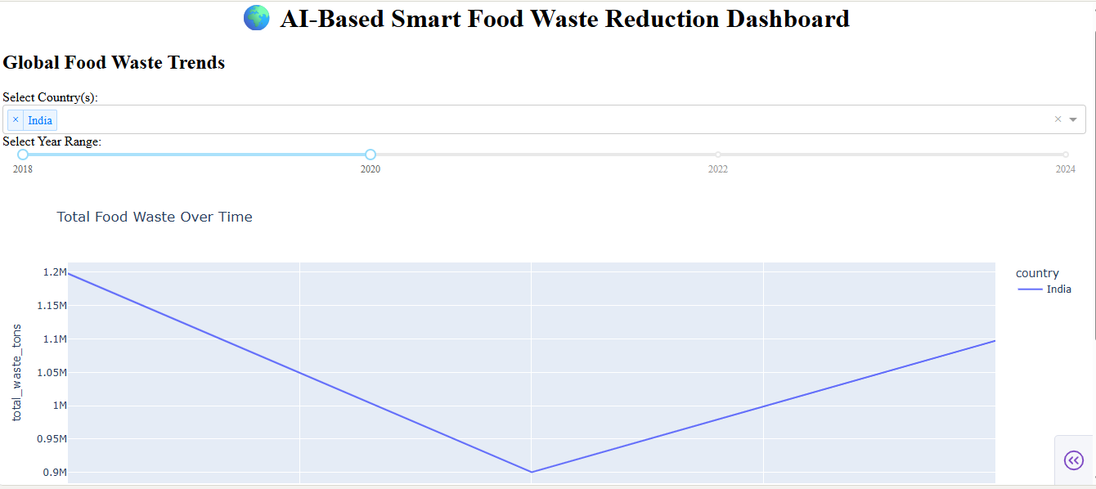
Screenshot of Output:

Slide 8
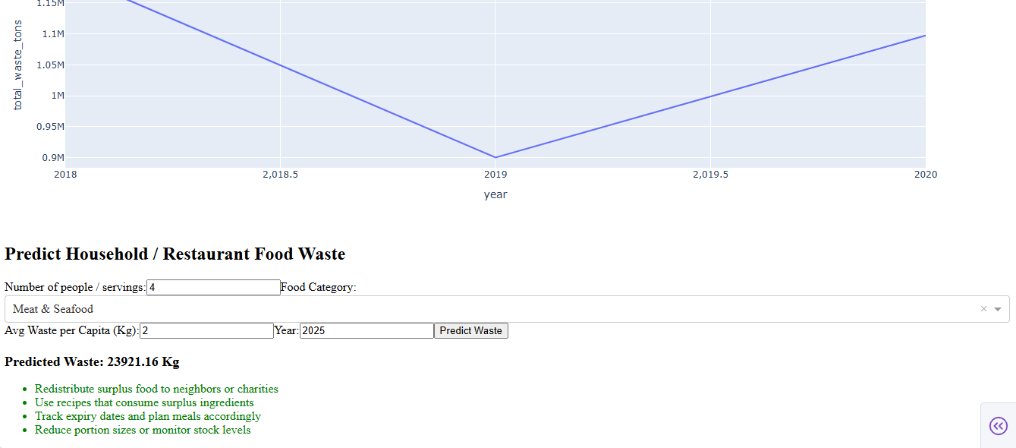

Slide 9
Conclusion:
The AI-Based Smart Food Waste Reduction System demonstrates how data science and machine learning can directly contribute to solving global sustainability issues. By combining accurate prediction models, interactive dashboards, and intelligent recommendations, the system empowers users to understand their consumption patterns and reduce wastage in a practical, meaningful way.
The project not only supports better decision-making but also promotes responsible food management for households and restaurants. With easy-to-use insights, optimized planning, and actionable suggestions, this solution helps users save money, reduce environmental impact, and build long-term sustainable habits.
Overall, the system highlights the powerful role of AI in reducing food waste and encourages society to move toward a cleaner, greener, and more resource-efficient future.
✨ Every small step in reducing waste leads to a big impact on the planet.
🌱 Smarter decisions today create a more sustainable tomorrow.
🌍 Together, technology and awareness can help build a waste-free world..

